Slide 1
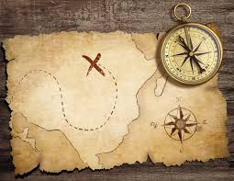
2016 Children Special Summer Program

Slide 2

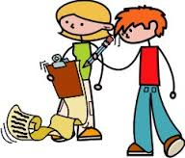

This summer
July to August, Sunday 9:00 to 10:30 am
Hi everyone! Do you know something very cool will happen in this summer?
We invite you to be the Leader-in-Training (L.I.T.)
There will be three children teams to lead:
1st – 2nd graders
3rd – 4th graders
5th – 6th graders

Slide 3
You will grow to be like Jesus!
Why do we have the summer program?
Teachers continue to grow like Jesus!
Kids will grow to be like Jesus!
Through the three Activity Stations / 20 minutes each
(1) Bible message
(2) Singspiration!
(3) Game and Craft

Slide 4
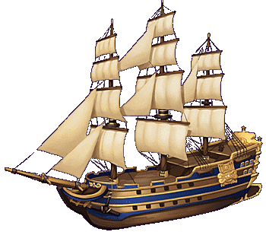
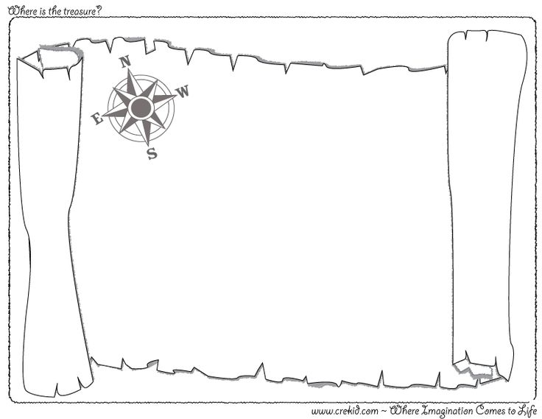
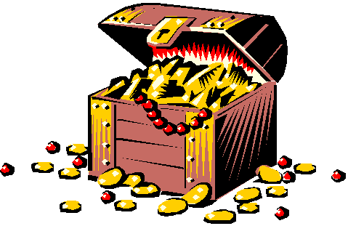

What will kids do?

Slide 5



What does a L.I.T. do?
Leadership
Teamwork
Encourager
No one left behind!
Always together
Finish well

Slide 6


Slide 7
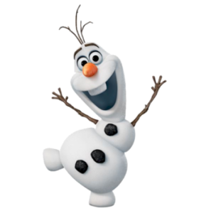
As a L.I.T., remember…
OLAF-PAS

Slide 8
As a L.I.T., remember…
On time
Lead
Activities
Fun

Slide 9
As a L.I.T., remember…
Puzzles
Attendance
Songs

